Slide 1
4 Language Design and Abstraction
Notes:
Analysis (Scanning)
From book:
CFG, Recursive Descent, AST, (Visitor+checker)
From project:
BoCoLa: Scanner, CFG, Recursive Descent, AST

Slide 2
Language Principles Control Structures FORTRAN
Design of Control Structures
Control structures govern primitive statements
FORTRANs control structures
Example (FORTRAN)
What makes a control regime good or bad?
The Structure Principle
Notes:
Design of Control Structures, what you should think about when you design control structures in your programming language.
Control structures governs the flow of control in a program, they act as schedulers or traffic manager by directing control to the primitive statements such as ADD and READ in FORTRAN that do the actual data processing work of the program.
Ex(FORTRAN): (IF-THEN-ELSE)
IF (Condition) GOTO 100
~case for FALSE~
GOTO 200
100 ~case for TRUE~
~continue execution of the rest~
What makes a control regime good or bad is the understandability!
The Structure Principle: The static structure of a program should correspond in a simple way with the dynamic structure of the corresponding computations.
This means that it should be possible to visualize the behavior of the program easily from its written form.

Slide 3
Language Principles Ctrl. Struct.
Confusion of syntax when writing code
Example Computed and Assigned GOTO in FORTRAN
The Syntactic Consistency Principle
Weak typed languages are also giving problems (FORTRAN)
FORTRAN violates the Defense in Depth principle
FORTRANs built in high-level control structure
Notes:
Ex(FORTRAN): (Computed GOTO)
GOTO (L1,L2,L3), I
Ex(FORTRAN): (Assigned GOTO) This is an indirect GOTO!
GOTO I, (L1,L2,L3)
ASSIGN 20 TO I
Syntactic Consistency Principle: Things which look similar should be similar and things which look different should be different.
This means, it is best to avoid syntactic forms that can be converted into other legal forms by a simple error!
FORTRAN is a weak typed language, for example can integer variables hold a number of things besides integers such as addresses and character strings.
Defense in Depth Principle: If an error gets through one line of defense(syntactic checking), then it should be caught by the next line of defense (type checking).
FORTRAN only have one built in high level control structure, the DO loop. The DO loop provides an easy way to construct counted loops.
The IF and GOTO control structures are low level (primitive) which high level control structures can be built upon.
The DO loop can be nested.
Example of DO loop counter:
DO 100 I=1, 32
A(I) = A(I)*2
100 CONTINUE

Slide 4
Language Principles Syntactic Structures
Languages are defined by lexics and syntax
Ignoring blanks everywhere... Bad…
The lack of reserved words
Algebraic notation was an important contribution
Precedence of operators
Linear syntactic organization
Notes:
The syntax of a language is the way that words and symbols are combined to form the statements and expressions.
The syntactic analysis phase of a compiler is often broken up into two parts, the lexical analyzer(scanner) and the syntactic analyzer(parser).
Example in FORTRAN, an identifier must start with a letter and be followed by no more than five letters and digits.
Example of a DO-loop syntax: <DO-loop> ::= DO <label> <var>=<exp>,<exp>
FORTRAN ignore all blanks in the source code. This will cause some problems if the coder write a little error in the source code.
Example:
DO 20 I=1. 100 just a variable named DO20I that is assigned with the integer value 1.100
DO 20 I=1, 100 Valid DO- loop counter
Modern languages are much alike natural languages and uses blanks to separate tokens.
In FORTRAN it is possible to use keywords as variable names!!!
One of the major selling points of FORTRAN are the ability to write quasi-algebraic notation.
Example: (-B+SQRT(B**2-4*A*C)) / (2*A)
Arithmetic operators have precedence(priority), and the order is:
Exponentiation, 2. Multiplication/Division, 3. Addition/Subtraction
Operators of the same precedence are done in the order from left to right.
FORTRAN has a linear syntactic organization, this means that statements are arranged in a simple sequence.
In structured languages some statements can be nested within others, this was later added to FORTRAN.

Slide 5
Language Principles Name Structures
The primitives bind names to objects
The constructor is the block
Blocks define nested scopes
Blocks simplify constructing large programs
Dynamic scoping allows context to vary
Static and dynamic scoping summarized
Notes:
Purpose of name structures is to organize the name space, that is the collection of names used in the program. In FORTRAN the primitive name structures are the declarations that define names by binding them to objects.
To execute more than one statement where one is permitted you can use a begin and end to surround the statements. This is called Block Structure
Example(Algol-58): for loop without block
for I := 1 step 1 until N do
sum := sum + Data(i)
Example with block:
for I := 1 step 1 until N do
begin
~do some work~
end
This is also called regularity in language design. A regular language is generally easier to learn and understand than an irregular one.
Nested scopes are used to define what variables are visible inside the scope, FORTRAN COMMON makes use of a type of nesting scopes to govern subprograms of the main program and variables inside the local scopes. This is to collect the names bound to declarations which are visible to all the statements in the block, this names are local to that block. And the statements can also be blocks, hence the nested scope. An inner block implicitly inherits access to all of the variables accessible to its immediately surrounding block these names are nonlocal. Names that are declared in the outmost block are global.
The goal of name structures is to limit the context with which the programmer must deal with at any given time, this is done with the aforementioned nested scope rules.
Code that is to be reused in many subprograms of the programs should be put in a COMMON(global) block(FORTRAN) that is accessible to all the subprograms. This is a part of the general guideline in language design which is called the Abstraction Principle, whenever a programmer must restate the same thing, or almost the same thing over and over again, he should find a way to abstract the common parts.
In FORTRAN it doesn’t work very good but it does in Algol, although Algol has its own problem with indiscriminant access to the data in the common block and FORTRAN didn’t.
The difference between static and dynamic scoping is for example that a variable declared in a global scope can vary from the original declaration in a local scope. Which is better has been a debated since at least 1960. Java is both, because if a variable is declared as a constant, then the value of it will never change, and if it is just declared as variable the value of it can change in the local scope. The variables in dynamic scoping is vulnerable to being called from another environment and get changed!!
Summary of static and dynamic scoping:
In dynamic scoping the meanings of statements and expressions are determined by the dynamic structure of the computations evolving in time.
In static scoping the meanings of statements and expressions are determined by the static structure of the program.

Slide 6
Language Principles Control Structures Algol-60
Primitive computational statements has changed little
Control structures are generalizations of FORTRANs
Nested statements are very important
Compound statements are hierarchical structures
Nesting led to structured programming
Notes:
In FORTRAN the control structures are built by primitives (I/O statements) that do not affect the flow of control. In Algol the I/O are performed by library procedures rather than specialized statements.
In Algol the function of control structures is to direct and manage the flow of control from assignment statement to another.
Algol has essentially the same structures as FORTRAN but in a generalized and regular form. FORTRAN only has a single simple unconditional statement such as GOTO. In Algol this restriction is removed and it can be another statement including for example another if- statements, it can also be a group of statements, it also have an else-part which is executed if the condition is false. This allows for a more symmetric analysis of the problem into two cases, one for true and one for false.
Algol control structures are more regular, more symmetric, more powerful and more general than FORTRANS. This is because FORTRAN has more restrictions. This removing of all restrictions also poses some problems.
The slogan for removing all restrictions in Algol is: Anything that you think you ought to be able to do, you will be able to do.
FORTRAN have some short comings when it comes to its IF statement, if there is only a single statement it can be written such as IF(X > Y) X =X/2, but if there are more than one following statements a GOTO is needed to jump over the statement that is not for example true as in this example:
IF(X <= Y) GOTO 100 // take notice of the negation of the greater than (>) sign, it is very important to negate, which a lot of programmers do forget if they put extra statements in the IF!!!!
X = X/2
Y = Y+DELTA
~TRUE~ continue executing here~
This makes it more difficult to modify a program, adding one statement may require modifying the entire IF-statement, this is one of the irregularities of FORTRAN that makes it harder to maintain. FORTRANs DO loop
doesn’t have this problem because it can be nested. The DO and CONTINUE form brackets which marks the beginning and end of the loop. The CONTINUE statements can be placed everywhere in a program and act as do
nothing statements.
Algol are designed to handle an arbitrary number of statements, it uses begin and end to compound a group of statements to be converted to “one” large statement. Begin and end are also used to delimit blocks which
defines nested scopes. This can lead to problems because begin and end are used for both defining scopes and grouping statements. It can still be a problem in Algol when you switch from a single statement to multiple
statements, if you forget to add begin and end! It is also easy to forget an end in a deeply nested program.
Algols compound statement is a good example of hierarchical structure, starting with simple statements and build up larger end more complex structures by a combination of these statements.
The Structure Principle: The static structure of the program should correspond in a simple way with dynamic structure of the corresponding computations.
This is how the nesting features of Algol control structures could make programmers more aware of the problems with reliable programming.
This made programmers more aware of how they should structure a program.

Slide 7
Language Principles Data Structures (Pascal)
Array Types
Record Types
Pointer Types
Notes:
The design of array types from static in FORTRAN to dynamic in Algol back to static in Pascal and to dynamic yet again in Ada. This looks to be a matter of designers taste which one is preferred, my own comment(Kalle).
The fundamental design decisions for static array types in Pascal are: 1. All types must be determinable at compile time. 2. The dimension are part of an array. The first decision is to be able to do type checking at compile time (all Pascal objects have static types, they cannot change at run-time), the second decision means that two array types are considered the same if their index types match and their base types match.
Record Types are one of the most important data structures in Pascal. This data structure allows arbitrary groupings of data, components of different types and a component in the record can also be a record type. It is similar to struct of C and essentially an object of an object oriented language like java. The difference between Array and Record types are that array types are homogenous and record types heterogenous.
Pascal offers the use of pointers, a version called typed pointers that allows the compiler to enforce strong typing even when pointers are used. Normally the system has no way of knowing the type of the memory location whose pointer is in. This can give some problems for example when you put a real number into a character variable.
Example:
var p: pointer;
x: real;
c: char;
begin
new(p);
p| := 3.14;
c := p|; //3.14 is put into a char variable!!!
end
Example with enforced strong typing:
var p: |real; //Typed pointer!!!
x: real;
c: char;
begin
new(p);
p| := 3.14;
c := p|; //Now the compiler sees this as an illegal assignment!!!
end
The elements of records can be pointers.

Slide 8
Language Principles Name Structures (ADA)
Parnas’s Principle
Packages support information hiding
Name access is by mutual consent
Packages as libraries
Packages permit shared data areas
Packages can be data structure managers
Generic packages allow multiple instantiation
Notes:
Parnas’s Principle of information hiding:
One must provide the intended user with all the information needed to use the module correctly and nothing more.
One must provide the implementor(the module creator) with all the information needed to complete the module and nothing more.
This means that the user of the module doesn’t know how it is implemented. The implementor doesn’t know how it will be used, except what is provided in the interface.
To modularize programs designed in ADA it provides the package type that supports information hiding.
The package have both private and public parts, the public parts can be accessed by using the use declaration or the dot(.) operator.
The package type are used to modularize the program, this construction is called a library. This package type doesn’t contain any data structures, just definitions of constants and subprograms(procedures) that are needed
by the implementation but are hidden from users.
Packages can also be designed to just contain data structures, an example are a buffer that two procedures can use to communicate characters with each other.
A common use of packages is to encapsulate a data structure and provide a representation independent interface for accessing it. For example when designing a stack package, it can be given some access that can be used
to check if the stack are empty, full or if one would like to push or pop and an stack error exception that will be used if someone for example are trying to pop from an empty stack.
In ADA a generic package can be created to allow multiple instantiations of a package by putting generic in front of the package. Example of creation of a generic package:
generic
package STACK is
procedure……..
procedure……..
function………..
function………..
end STACK
Then a programmer can instantiate several instances of the generic package by writing:
package STACK1 is new STACK;
package STACK2 is new STACK;
The new instances of the generic STACK package can be accessed by the dot operator as follows:
STACK1.PUSH(I);
STACK2.POP(N);
The use construct cannot be used to access the stack this way, because the programmer would never know which stack instance that will be accessed.
Packages can only be statically instantiated unlike procedures that can be dynamically instantiated.
The only way to dynamically instantiate a package is to instantiate a procedure where a package are declared.

Slide 9
Language Translation
Language Definition
Defined tokens
Create BoCoLa AST
Concrete BoCoLa example
Concrete BoCoLa AST
Visitor Pattern and Code Generation
Modification of runtime system
Extension of synchronization
Results

Slide 10

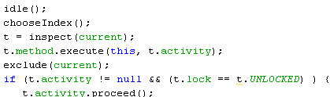

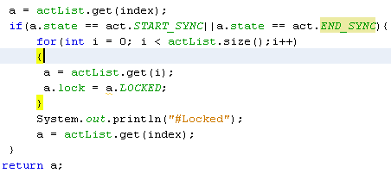
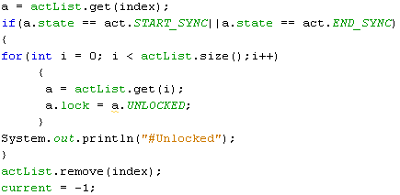
Modification of runtime system
Participant
Activity
Lock
Locked
Unlocked
Notes:
Modified runtime system allow us to execute in right order – synchronize. If in participant list there are synchronized bots when all other participants are locked and they have to wait until synchronized participants finish.

Slide 11
Extension of synchronization
sync
List of participants
Work
Move
null
sync
Move
Work
Move
null

Slide 12
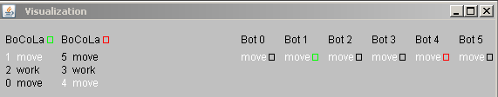
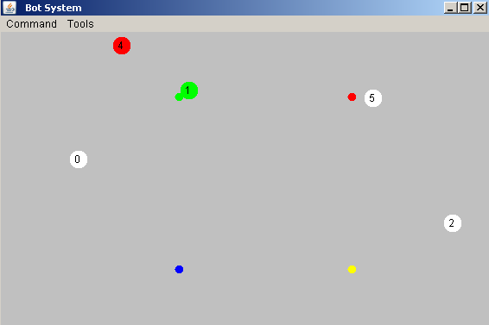
Results
Notes:
Picture of the Bots System runtime. Here are collaborations between bots.
By using the keyword sync it takes longer to execute, because of the wait. During synchronized bot execution no other bots execute. This guarantee right order of bots execution (move or/and work).

Slide 13
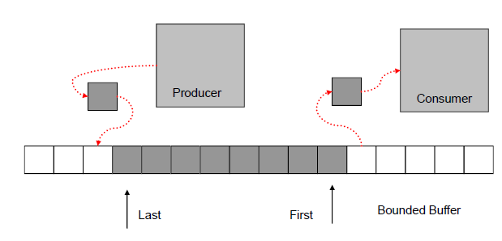
Association and Bounded Buffer
Association
Bounded Buffer
Notes:
Associations support associative modeling and programming through abstractions over collaboration. Associations support objectification of integrated collaboration aspects and role aspects. Classification, specialization and aggregation are available.
In associations directives (sequencing rules for interactions among the participating objects) are central, partial descriptions related to the participating objects. The objects execute their own contributions to the collaboration in their context. An active object participating in various associations execute contributions from the directives interleaved.
Bounded Buffer is a classical example of multi-process synchronization problem.
Producer produces artifacts and Consumer consumes artifacts, this is happening concurrently.
Production times and consummation times are not related.
Producer delivers each artifact produced to Bounded_Buffer.
Consumer retrieves each artifact for consummation from Bounded_Buffer.
Producer and Bounded_Buffer are synchronized during the transfer of an artifact. Consumer and Bounded_Buffer are synchronized during transfer of an
artifact.
Bounded_Buffer is bounded, in example a maximum number of elements may be kept in the buffer. If Bounded_Buffer is full, no more elements may be
added to the buffer and Producer has to wait for Bounded_Buffer not to be full. If Bounded_Buffer is empty no elements can be retrieved from the buffer
and Consumer has to wait for Bounded_Buffer not to be empty.
This problem can be solved by using semaphores, using fillCount and emptyCount to solve the problem to the full and empty buffer problem.
The other problem that needs to be solved are in example when more than one Producer are trying to decrement the emptyCount at the same time. This is
solved by the using a binary semaphore called a mutex (mutual exlusion).

